Slide 1
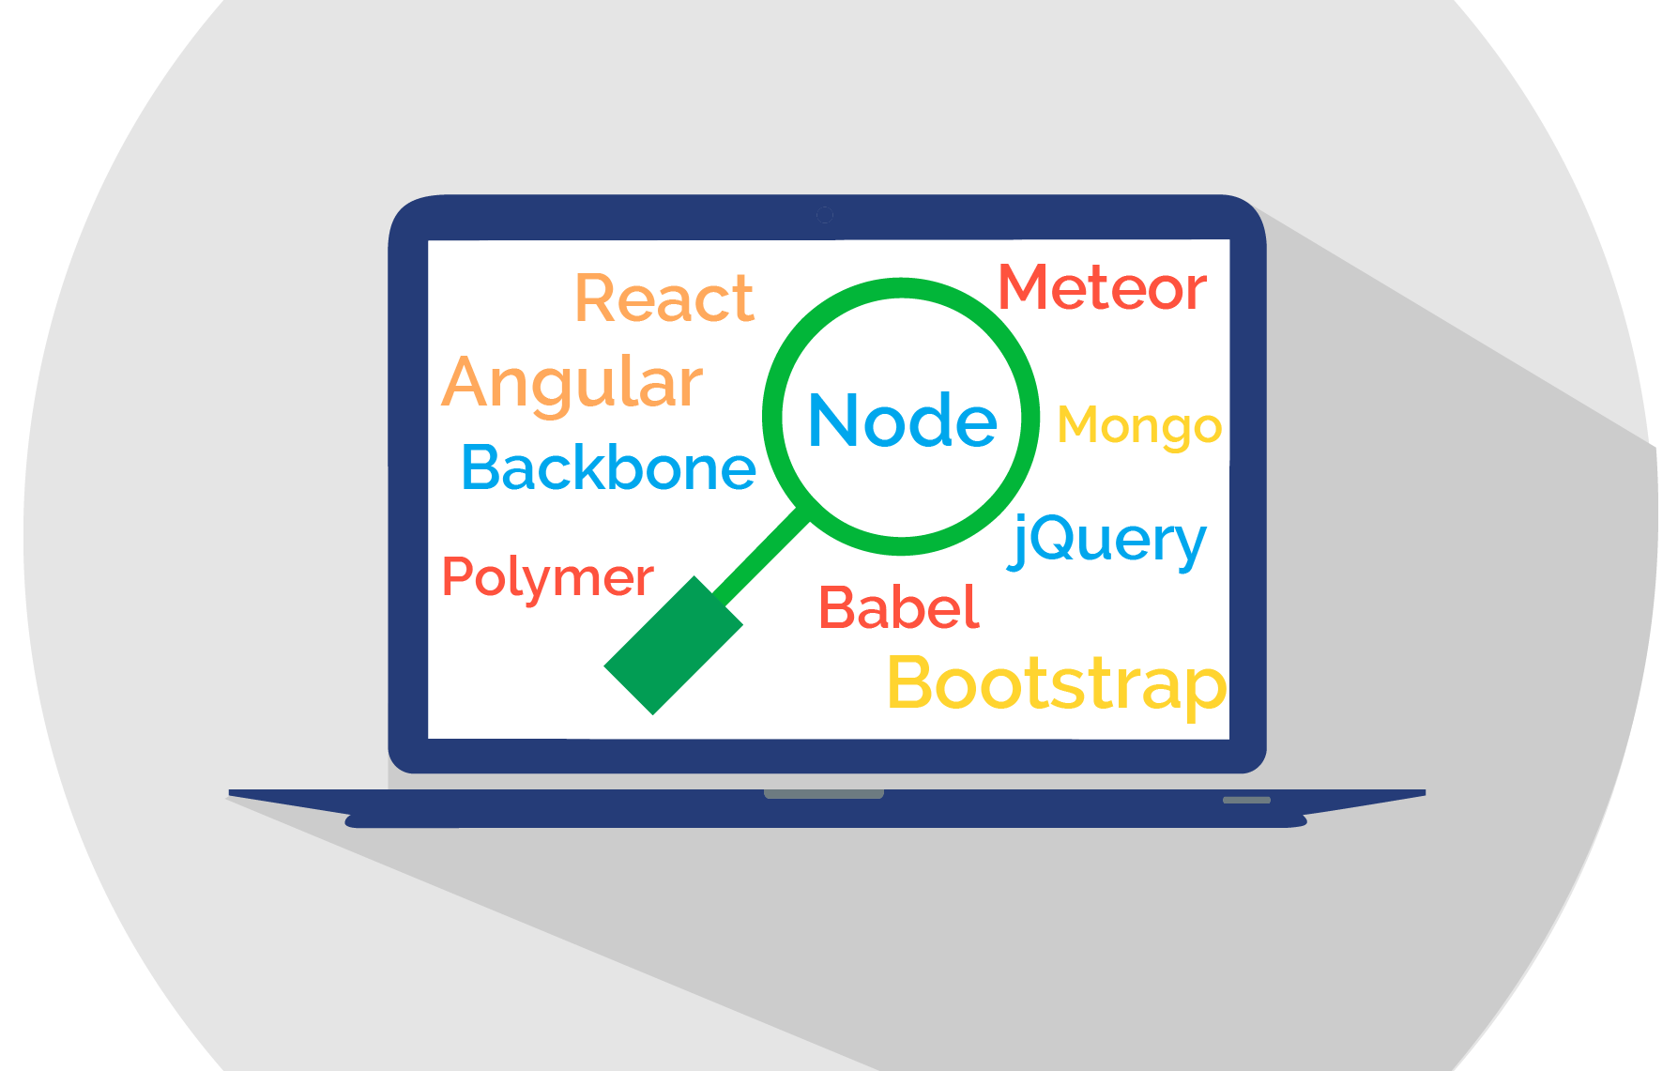
ClearCode Overview
Summer 2020
Copyright (c) nexB Inc. and others. License: CC-BY-SA-4.0 Visit https://www.aboutcode.org/ and https://github.com/nexB/clearcode-toolkit/

Slide 2
What is ClearCode? Why?
A tool to mirror ClearlyDefined data
  And keep it in sync, up-to-the-minute
  Syncing everything: definitions, harvests, etc.
Why? To use the data wholesale for any use case
  Bulk analysis and queries
  Behind-the-firewall, private usage
  Integration in various solutions, database, software products.
  ...

Slide 3
ClearCode
sync files via API
ClearCode load DB Load files as CDItem
ClearlyDefined
1
2
About 10M "definitions"
About 30M "harvests"
About 900GB dumped
About 3 to 5MB /day new data
Also has load/dump REST API for offline sync
ClearCode
"CDItem DB"
3
ClearCode
sync files to DB direct
Incremental Export/Import Client
As JSON, since a date
Rest API
endpoint to lookup items
4
5
Other ClearCode DB

Slide 4
Tech
Python with PostgreSQL
  Django for ORM, DRF for API, Click for CLI
Data stored as original JSON as Gzipped field
Record key is the original file path
Data can also be synced as plain JSON files
Sync is multithreaded and polite by default using etags, and throttling and caching
Utilities to convert CD Coordinates to "Package URLs" purls
Apache-licensed

Slide 5
Challenges
File storage is impractical outside of Azure
  ~ 100 million files and dirs... but close to 50 million dirs!
Using filesystem paths as a key does not work at that scale
Once compressed in a DB, the dataset is much easier to handle
  less than one TB
Cloudflare seems to be a source of many subtle and painful network issues
Some ClearlyDefined API have some unstable behaviour which are hard to qualify

Slide 6
Next Steps
Open sourced today at https://github.com/nexB/clearcode-toolkit/
Robust enough, running continuously for several months to sync up the data
We have a whole seed available to share. The challenge is the distribution of ~ 1TB of data
This is used as a dataset for a Google Summer of Code project to apply AI/ML to spot inconsistencies and improve ScanCode license detection

Slide 7
Contact
Contact persons
  Michael Herzog
  mjherzog@nexb.com
  + 1 650 380 0680
  Philippe Ombredanne
  pombredanne@nexb.com
  + 1 650 799 0949
More information
  https://www.nexb.com/ and https://www.aboutcode.org/
Notes:
1

Slide 8

Credits
Special thanks to all the people who made and released these awesome free resources:
Presentation template by SlidesCarnival
Photographs by Unsplash
And all the software authors that made ClearCode, AboutCode and ScanCode possible
© 2017 nexB

